Slide 1
Chapter 5
Input/Output Management
Operating System (OS)
Asst. Prof. Jhumi Thapa
Computer Engineering Department

Slide 2
Introduction
Input/output or I/O is the communication between an information processing system, such as a computer, and the outside world, possibly a human or another information processing system.
Inputs are the signals or data received by the system and outputs are the signals or data sent from it.
The term can also be used as part of an action; to "perform I/O" is to perform an input or output operation.
OS controls all of the computer‘s I/O devices. For that, the OS should:
  issue commands to handle the I/O devices
  catch the interrupts
  handle the errors
  Provide the interface between devices and rest of the system.

Slide 3
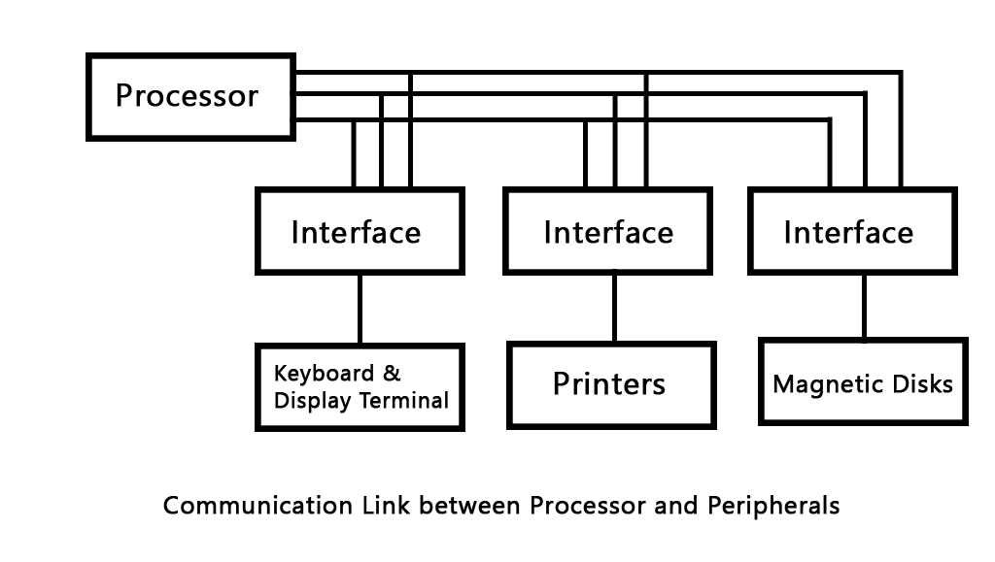
I/O Interface
I/O Interface is used as an method which helps in transferring of information between the internal storage devices i.e. memory and the external peripheral device . A peripheral device is that which provide input and output for the computer, it is also called Input-Output devices.
I/O interface can be software
and hardware.

Slide 4
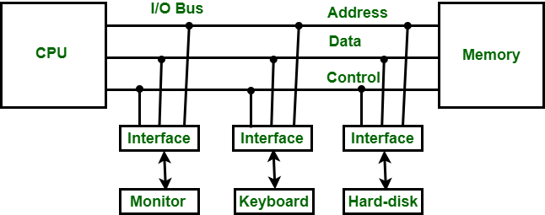
Need of I/O Interface
The nature of peripheral devices is electromagnetic and electro-mechanical. The nature of the CPU is electronic. There is a lot of difference in the mode of operation of both peripheral devices and CPU.
There is also a synchronization mechanism because the data transfer rate of peripheral devices are slow than CPU.
In peripheral devices, data code and formats are differ from the format in the CPU and memory.
The operating mode of peripheral devices are different and each may be controlled so as not to disturb the operation of other peripheral devices connected to CPU.

Slide 5
Principles of I/O Hardware
Different people look at I/O hardware differently
Electrical engineers look in terms of chips, wires, motors, power supplies and other physical components that make up the hardware
Programmers look at the interface presented to the software (the commands the hardware accepts, the function it carries out and the errors that can be reported back)
We are concerned with programming I/O devices, not designing, building or maintaining them.
Our interest is restricted to how the hardware is programmed not, how it works inside.

Slide 6
I/O Devices
I/O devices are the pieces of hardware used by a human (or other system) to communicate with a computer. For instance, a keyboard or computer mouse is an input device for a computer, while monitors and printers are output devices. I/O devices can be roughly divided into:
Block devices
  stores information in a fixed sized block, each one with its own address.
  common block size ranges from 512 bytes to 32,768 bytes
  data transfer takes place in blocks
  block addressable not byte addressable
  e.g. Hard disks, CD-ROMs, USB sticks etc.
Character devices
  delivers or accepts a stream of characters, without regard to any block structure
  they are not addressable
  e.g. printers, network interfaces, mice etc.

Slide 7
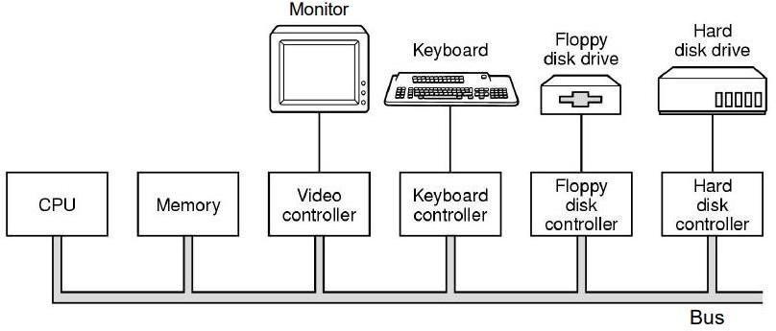
Device Controllers
The Device Controller works like an interface between a device and a device driver.
I/O units (Keyboard, mouse, printer, etc.) typically consist of a mechanical component and an electronic component where electronic component is called the device controller.
A device controller is a piece of hardware that receives commands from the system bus, translates them into device actions and reads/writes the data onto the system bus.
A device controller is a part of a computer system that makes sense of the signals going to, and coming from the CPU.

Slide 8
Device Controllers
There are many device controllers in a computer system
Any device connected to the computer is connected by a plug and socket, and the socket is connected to a device controller
In personal computer, device controller usually takes the form of a chip on the parent board
Many controllers can handle two, four or even eight identical devices

Slide 9
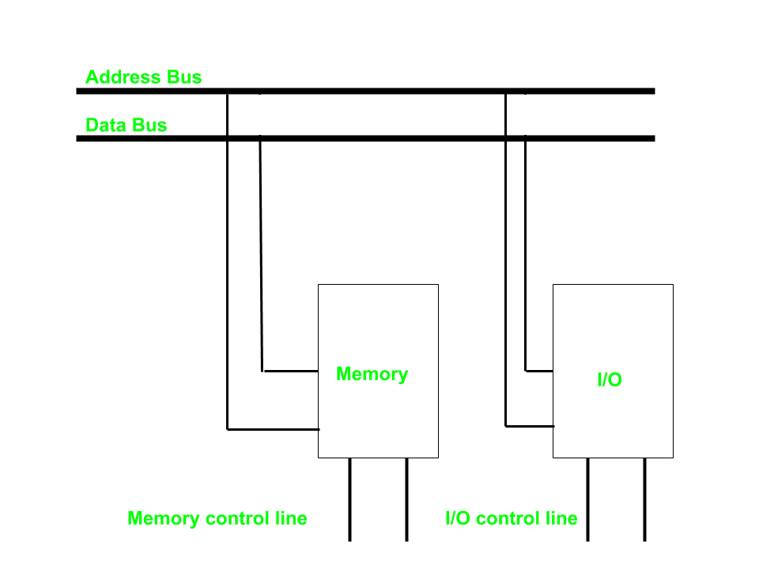
I/O Mapped or Isolated I/O
I/O mapped, in which we have common bus(data and address) for I/O and memory but separate read and write control lines for I/O.
CPU distinguishes between memory and
i/o using control signals.
i/o devices have their own addresses.
Ways to Communicate between CPU and
i/o devices through buses.

Slide 10
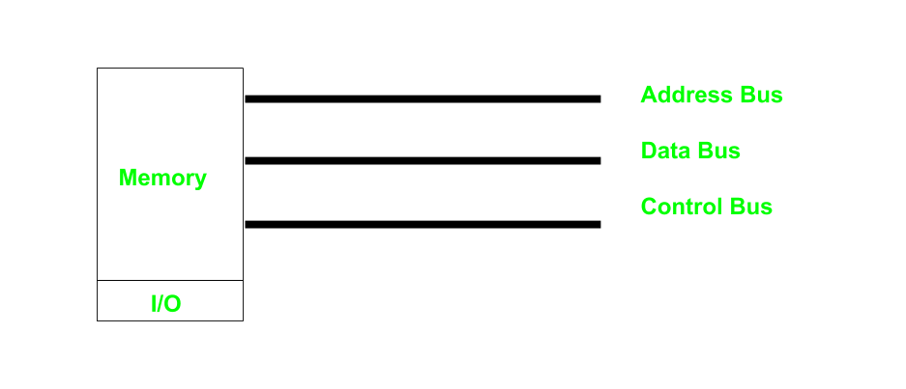
Memory – Mapped I/O
In this case every bus in common due to which the same set of instructions work for memory and I/O and same address space is shared by memory and I/O devices due to which addressing capability of memory become less because some part is occupied by the I/O.
Processor does not differentiate between memory and I/O. Treats I/O devices also like memory devices.
I/O devices are mapped into memory space.
I/O devices are allotted memory addresses.

Slide 11
I/O mapped vs Memory Mapped I/O
I/O mapped | Memory Mapped I/O
Memory and I/O have separate address space | Both have same address space
All address can be used by the memory | Due to addition of I/O addressable memory become less for memory
Separate instruction control read and write operation in I/O and Memory | Same instructions can control both I/O and Memory
In this I/O address are called ports. | Normal memory address are for both
More efficient due to separate buses | Lesser efficient
Larger in size due to more buses | Smaller in size
It is complex due to separate logic is used to control both. | Simpler logic is used as I/O is also treated as memory only.

Slide 12
Organization of I/O functions(Modes of transfer)
Three techniques for performing I/O are:
  Programmed I/O, the processor issues an I/O command on behalf of a process to an I/O module; that process then busy waits for the operation to be completed before proceeding.
  CPU has direct control over I/O(sensing status/read/write commands/transferring data)
  CPU waits for i/o module to complete operations
  wastes CPU time
  Interrupt-driven I/O, the processor issues an I/O command on behalf of a process
    if non-blocking – processor continues to execute instructions from the process that issued the I/O command
    if blocking – the next instruction the processor executes is from the OS, which will put the current process in a blocked state and schedule another process
  Direct Memory Access (DMA), a DMA module controls the exchange of data between main memory and an I/O module

Slide 13
Direct Memory Access
Enables data transfer between i/o and memory without CPU intervention.
Need a hardware to implement DMA technique: DMAC: DMA Controller.
Feature of computer systems that allows certain hardware subsystems to access main memory (RAM), independent of the central processing unit (CPU).
Without DMA, when the CPU is using programmed input/output, it is typically fully occupied for the entire duration of the read or write operation, and is thus unavailable to perform other work.
With DMA, the CPU first initiates the transfer, then it does other operations while the transfer is in progress, and it finally receives an interrupt from the DMA controller when the operation is done.
This feature is useful when the CPU needs to perform useful work while waiting for a relatively slow I/O data transfer.
Many hardware systems such as disk drive controllers, graphics cards, network cards and sound cards use DMA.

Slide 14
Disk read-write without a DMA
The disk controller reads the block from the drive serially, bit by bit, until the entire block is in the controller’s buffer.
Next, it computes the checksum to verify that no read errors have occurred.
Then the controller causes an interrupt, so that OS can read the block from controller’s buffer (a byte or a word at a time) by executing a loop.
After reading every single part of the block from controller device register, the operating system will store them into the main memory.
Drive
Buffer
Disk
Controller
Main
Memory
CPU
Bus

Slide 15
Disk read-write using DMA
1. CPU programs DMA controller
Drive
Buffer
DMA Controller
Disk
Controller
Main
Memory
CPU
Bus
Step 1: First the CPU programs the DMA controller by setting its registers so it knows what to transfer where.
It also issues a command to the disk controller telling it to read data from the disk into its internal buffer and verify the checksum.
When valid data are in the disk controller’s buffer, DMA can begin.

Slide 16
Disk read-write using DMA
1. CPU programs DMA controller
Drive
Buffer
2. DMA requests transfer to memory
DMA Controller
Disk
Controller
Main
Memory
CPU
Bus
Step 2: The DMA controller initiates the transfer by issuing a read request over the bus to the disk controller.
This read request looks like any other read request, and the disk controller does not know (or care) whether it came from the CPU or from a DMA controller.

Slide 17
Disk read-write using DMA
1. CPU programs DMA controller
Drive
Buffer
2. DMA requests transfer to memory
DMA Controller
Disk
Controller
3. Data transferred
Main
Memory
CPU
Bus
Typically, the memory address to write to is on the bus’ address lines, so when the disk controller fetches the next word from its internal buffer, it knows where to write it.
Step 3: The write to memory is another standard bus cycle.

Slide 18
Disk read-write using DMA
1. CPU programs DMA controller
Drive
Buffer
4. ACK
2. DMA requests transfer to memory
DMA Controller
Disk
Controller
3. Data transferred
Main
Memory
CPU
Bus
Step 4: When the write is complete, the disk controller sends an acknowledgement signal to the DMA controller, also over the bus.
The DMA controller then increments the memory address to use and decrements the byte count.
If the byte count is still greater than 0, steps 2 to 4 are repeated until it reaches 0.

Slide 19
Disk read-write using DMA
1. CPU programs DMA controller
Drive
Buffer
4. ACK
2. DMA requests transfer to memory
DMA Controller
Disk
Controller
3. Data transferred
Main
Memory
CPU
Bus
At that time, the DMA controller interrupts the CPU to let it know that the transfer is now complete.
When the OS starts up, it does not have to copy the disk block to memory; it is already there.

Slide 20
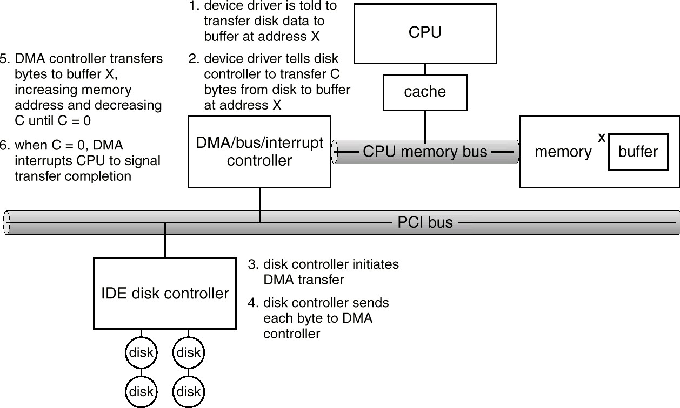
Six Step Process to Perform DMA Transfer

Slide 21
Goals of I/O Software
Device independence
  It should be possible to write programs that can access any I/O devices without having to specify the device in advance.
  For example, a program that reads a file as input should be able to read a file on a hard disk, a CD-ROM, a DVD, or a USB stick without having to modify the program for each different device.
Uniform naming
  The name of the device should simply be a string or an integer and do not depend on the device in any way.
  All the files and devices are addressed the same way: by a path name
Error Handling
  In general, the error should be handled as close to the hardware as possible
  If any controller generates error then it tries to solve that error itself. If controller cant solve then device deriver should handle the error.
  Propagate errors up only when lower layer cannot handle it.
  For example, if controller discovers read error, it should try to correct the error itself. If it cannot, the device driver should handle it.

Slide 22
Goals of I/O Software
Synchronous (blocking) Vs. Asynchronous (interrupt driven) transfers
  Most of devices are synchronous device. CPU starts transfer and goes off to do something else until interrupt occurs.
  It is up to the OS to make the operation that are interrupt driven look blocking to the user programs
Buffering
  Often, data that comes off a device cannot be stored directly to its final destination(memory) due to various reasons.
  buffer is the intermediate destination
Dedicated Vs Shared devices
  Devices that can be used by many users at a time are sharable. E.g. Disk (multiple users can open files from the same disk at the same time)
  Some devices have to be dedicated to a single person. E.g. tapes
Basically, input/output software organized in the following four layers:
  Interrupt handlers
  Device drivers
  Device-independent input/output software
  User-space input/output software

Slide 23
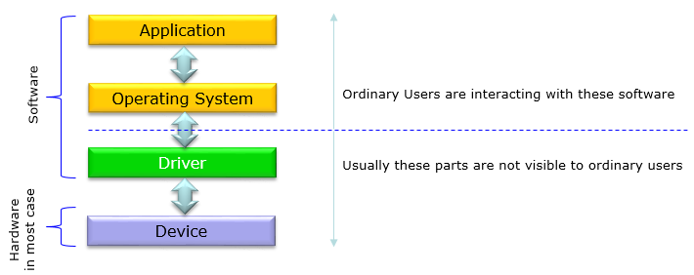
Device Drivers
I/O devices which are plugged with computer have some specific code for controlling them. This code is called device driver.
Each device driver normally handles one device type ,at most one class of closely related devices.
Device drivers are software components that enable the operating system to communicate with specific hardware devices.

Slide 24
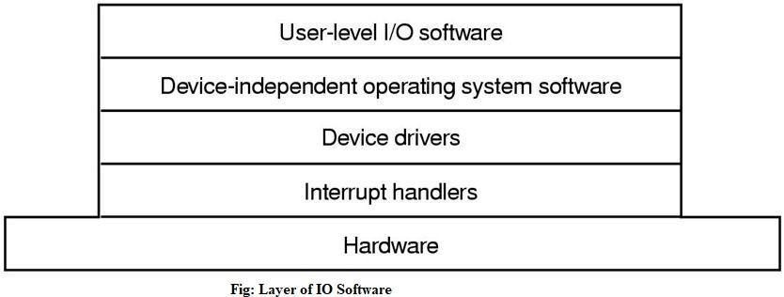
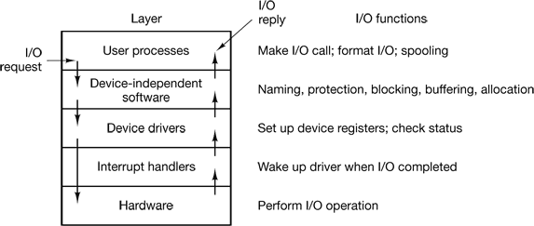
Goals of I/O Software
In every input/output software, each of the above given four layer has a well-defined function to perform and a well-defined interface to the adjacent layers.
The figure given below shows all the layers along with hardware of the input/output
Here is another figure shows all the layers of the input/output software system along with their principal functions.

Slide 25
Device Independent I/O Software
Although some of the I/O software is device specific, other parts of it are device independent. The basic function of device-independent software is to perform the I/O functions that are common to all devices and provide uniform interface to user-level software.
Functions of device independent I/O software
i. Uniform interfacing for device drivers
ii. Buffering
iii. Error Reporting
iv. Allocating and releasing dedicated devices
v. Providing a device-independent block size

Slide 26
User-Space I/O Software
These are the libraries which provide richer and simplified interface to access the functionality of the kernel or ultimately interactive with the device drivers. Most of the user-level I/O software consists of library procedures with some exception like spooling system which is a way of dealing with dedicated I/O devices in a multiprogramming system.
I/O Libraries (e.g., stdio) are in user-space to provide an interface to the OS resident device- independent I/O SW. For example putchar(), getchar(), printf() and scanf() are example of user level I/O library stdio available in C programming.

Slide 27
Polled I/O
The simplest form of I/O is to have the CPU do all the work. This method is called programmed I/O.
Polling is the simplest way for communicate with the processor.
The process of periodically checking status of the device to see if it is time for the next i/o operation is called polling.
This method is inefficient as it keeps checking one i/o device after other
This behavior is often called polling or busy waiting.

Slide 28
Interrupt Driven I/O
An alternative scheme for dealing with i/o is the interrupt-driven method.
The basic interrupt mechanism works as follows.
The CPU hardware has a wire called the interrupt-request line that the CPU senses after executing every instruction.
When the CPU detects that a controller has asserted a signal on the interrupt request line, the CPU saves a small amount of state, such as the current value of the instruction pointer, and jumps to the interrupt-handler routine at a fixed address in memory.
The interrupt handler determines the cause of the interrupt, performs the necessary processing, and executes a return from interrupt instruction to return the CPU to the execution state prior to the interrupt.
We say that the device controller raises an interrupt by asserting a signal on the interrupt request line, the CPU catches the interrupt and dispatches to the interrupt handler, and the handler clears the interrupt by servicing the device.

Slide 29
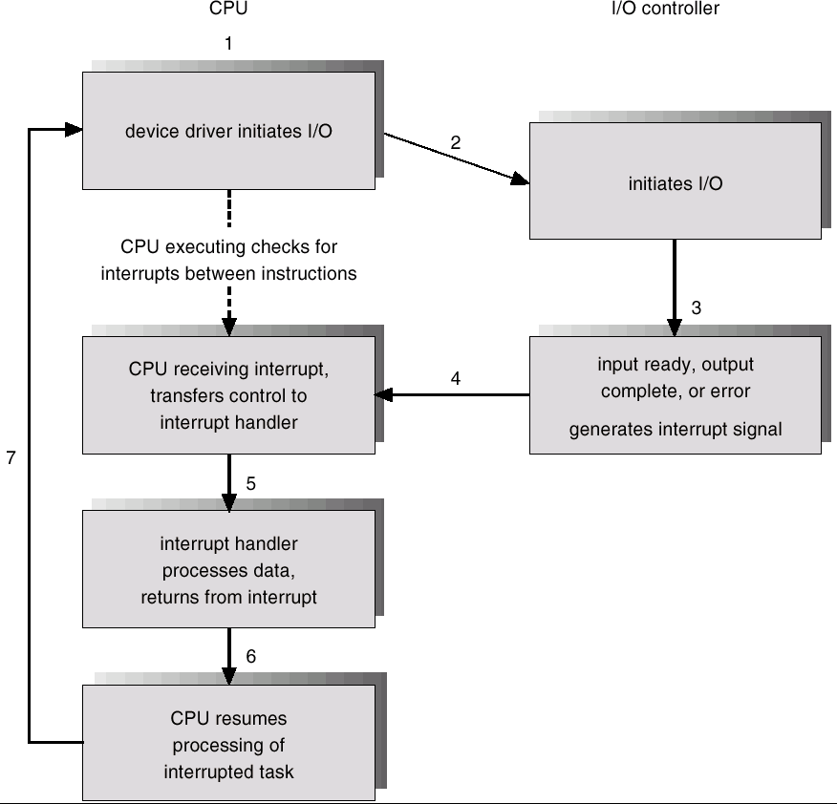
Interrupt – Driven I/O Cycle

Slide 30
Character User Interface and Graphical User Interface
GUI and CUI are two types of User Interfaces. GUI stands for Graphical User Interface while CUI stands for Character User Interface. In this article we will be discussing the differences between these two interfaces and which one has advantages over the other.
User Interface: User Interface comprises of everything the user can use to interact with the computer. It is basically the means by which the user and computer system can interact using input and output devices.
GUI: GUI stands for Graphical User Interface. This is a type of user interface where user interacts with the computer using graphics. Graphics include icons, navigation bars, images etc. Mouse can be used while using this interface to interact with the graphics. It is a very user friendly interface and requires no expertise. Eg: Windows has GUI.
CUI: CUI stands for Character User Interface. This is a type of user interface where user interacts with computer using only keyboard. To perform any action a command is required. CUI is precursor of GUI and was used in most primitive computers. Most modern computers use GUI and not CUI. Eg: MS-DOS has CUI.

Slide 31
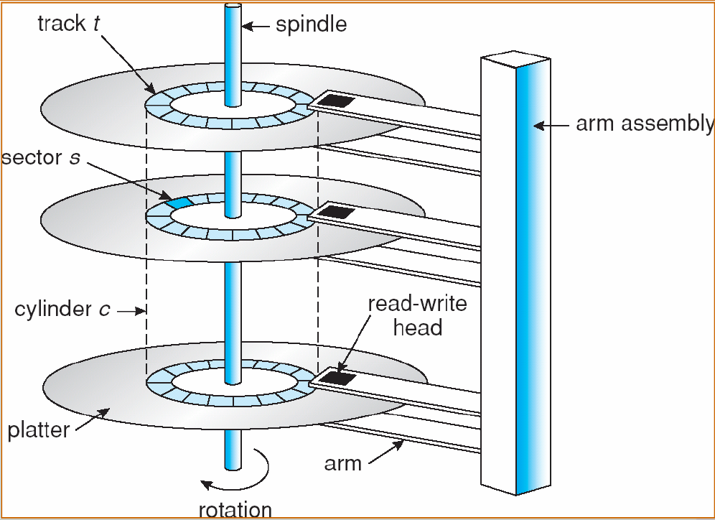
Disk
A disk consists of several platters
Each disk platter has a flat circular shape, like a CD
The two surfaces of a platter are covered with a magnetic material
A read-write head "flies" just above each surface of every platter
The heads are attached to a disk arm that moves all the heads as a unit
The surface of a platter is logically divided into circular tracks, which are subdivided into sectors
The set of tracks that are at one arm position makes up a cylinder
There may be thousands of concentric cylinders in a disk drive, and each track may contain hundreds of sectors

Slide 32
Disk Scheduling
Disk scheduling is done by operating systems to schedule I/O requests arriving for disk.
Disk scheduling is also known as I/O scheduling.
OS is responsible to use the hardware efficiently –for the disk drive this means fast seek, latency and transmission time.
For most disks, the seek time dominates the other two times, so reducing the mean seek time can improve system performance substantially.
Disk I/O time = seek time + rotational delay + transfer time
Seek: Position head over desired cylinder/track. Seek time depends on how fast the hardware moves the arm.(seek time represent time taken to reach up to desired track)
Transfer time: time to move the bytes from disk to memory.

Slide 33
Disk Arm Scheduling Algorithm
Following are different types of Disk Arm Scheduling Algorithm
  FCFS (First Come First Serve) / FIFO (First In First Out)
  SSTF (Shorted Seek Time First)
  SCAN
  C-SCAN
  LOOK (Elevator)
  C-LOOK

Slide 34
Example for Disk Arm Scheduling Algorithm
Consider an imaginary disk with 51 cylinders. A request comes in to read a block on cylinder 11. While the seek to cylinder 11 is in progress, new requests come in for cylinders 1, 36, 16, 34, 9, and 12, in that order.
Starting from the current head position, what is the total distance (in cylinders) that the disk arm moves to satisfy all the pending requests, for each of the following disk scheduling Algorithms?

Slide 35
FCSC (First Come First Serve) / FIFO (First In First Out)
Here requests are served in the order of their arrival.
Disk movement will be 11, 1, 36, 16, 34, 9 and 12.
Total cylinder movement: (11-1) + (36-1) + (36-16) + (34-16) + (34-9) + (12-9) = 111
0
1
9
12
16
34
36
50
11
1, 36, 16, 34, 9, 12
1
36
16
34
9
12

Slide 36
SSTF (Shortest seek time first)
We can minimize the disk movement by serving the request closest to the current position of the head.
Disk movement will be 11, 12, 9, 16, 1, 34 and 36.
Total cylinder movement: (12-11) + (12-9) + (16-9) + (16-1) + (34-1) + (36-34) = 61
0
1
9
12
16
34
36
50
11
1, 36, 16, 34, 9, 12
12
9
16
1
34
36

Slide 37
SCAN
From the current position disk arm starts in up direction and moves towards the end, serving all the pending requests until end.
At that end arm direction is reversed (down) and moves towards the other end serving the pending requests on the way.
This is also called as elevator algorithm.

Slide 38
SCAN
Here first it moves in up direction then goes in down direction
Disk movement will be 11, 12, 16, 34, 36, 50, 9 and 1.
Total cylinder movement: (12-11) + (16-12) + (34-16) +(36-34) +(50-36) + (50-9) + (9-1) = 88
0
1
9
12
16
34
36
50
11
1, 36, 16, 34, 9, 12
12
16
34
36
9
50
1

Slide 39
C-SCAN
From the current position disk arm starts in up direction and moves towards the end, serving request until end.
At the end the arm direction is reversed (down), and arm directly goes to other end and again continues moving in upward direction.

Slide 40
C-SCAN
Here first it moves in up direction then goes in down direction
Disk movement will be 11, 12, 16, 34, 36, 50, 0, 1 and 9.
Total cylinder movement: (12-11) + (16-12) + (34-16) +(36-34) +(50-36) + (50-0) + (1-0)+ (9-1) = 98
0
1
9
12
16
34
36
50
11
1, 36, 16, 34, 9, 12
12
16
34
36
0
50
1
9

Slide 41
LOOK
Keep moving in the same direction until there are no more outstanding requests pending in that direction, then algorithm switches the direction.
After switching the direction the arm will move to handle any request on the way. Here first it moves in up direction then goes in down direction.
In this algorithm, the software maintains 1 bit: the current direction bit, which takes the value either UP or DOWN.

Slide 42
LOOK
Here first it moves in up direction then goes in down direction
Disk movement will be 11, 12, 16, 34, 36, 9 and 1.
Total cylinder movement: (12-11) + (16-12) + (34-16) + (36-34) + (36-9) + (9-1) = 60
0
1
9
12
16
34
36
50
11
1, 36, 16, 34, 9, 12
12
16
34
36
9
1

Slide 43
C-LOOK
Keep moving in the same direction until there are no more outstanding requests pending in that direction, then algorithm switches direction.
When switching occurs the arm goes to the lowest numbered cylinder with pending requests and from there it continues moving in upward direction again.

Slide 44
C-LOOK
Here first it moves in up direction then goes in down direction
Disk movement will be 11, 12, 16, 34, 36, 1 and 9.
Total cylinder movement: (12-11) + (16-12) + (34-16) + (36-34) +(36-1)+(9-1) = 68
0
1
9
12
16
34
36
50
11
1, 36, 16, 34, 9, 12
12
16
34
36
1
9

Slide 45
Example for Disk Arm Scheduling Algorithm [Exercise]
Suppose that a disk drive has 200 cylinders, numbered 0 to 199 and order of request is: (82,170,43,140,24,16,190). And current position of Read/Write head is : 50.
Starting from the current head position, what is the total distance (in cylinders) that the disk arm moves to satisfy all the pending requests, for each of the following disk scheduling Algorithms?
  FCFS/FIFO (642)
  SSTF (208)
  SCAN (332)
  C-SCAN (391)
  LOOK (314)
  C-LOOK (341)

Slide 46
RAID
RAID (Redundant Array of Independent Disks)
RAID is a data storage virtualization technology that combines multiple physical disk drive components into a single logical unit for the purposes of data redundancy, performance improvement, large storage capacity or all.
Data is distributed across the drives in one of several ways, referred to as RAID levels, depending on the required level of redundancy and performance.
All RAID have the property that the data are distributed over drives, to allow parallel operation.
There are 7 levels of RAID.

Slide 47
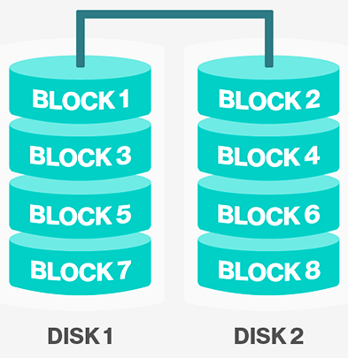
RAID 0 (Striping)
It splits data (file) into blocks of data.
Stripe the blocks across disks in the system.
In the diagram to the right, the odd blocks are written to disk 1 and the even blocks to disk 2.
It is easy to implement.
No parity calculation overhead is involved.
It provides good performance by spreading the load across many channels and drives.
It provides no redundancy or error detection.
Not true RAID because there is no fault tolerance. The failure of just one drive will result in all data in an array being lost.
After certain amount of drives, performance does not increase significantly.
It requires minimum 2 drives to implement.

Slide 48
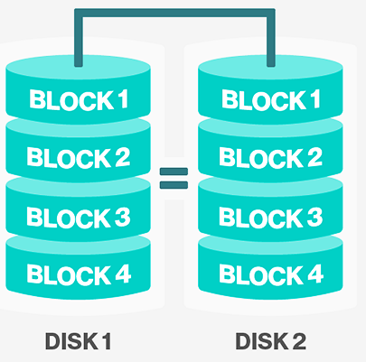
RAID 1 (Mirroring)
A complete file is stored on a single disk.
A second disk contains an exact copy of the file.
It provides complete redundancy of data.
Read performance can be improved
  same file data can be read in parallel
Write performance suffers
  must write the data out twice
Most expensive RAID implementation.
It requires twice as much storage space.
In case a drive fails, data do not have to be rebuild, they just have to be copied to the replacement drive.
The main disadvantage is that the effective storage capacity is only half of the total drive capacity because all data get written twice.

Slide 49
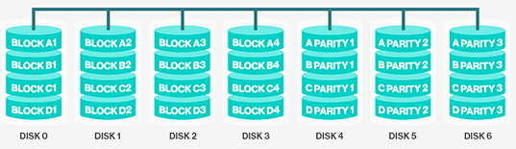
RAID 2 (Bit-level striping using a Hamming Code parity)
It stripes data at bit level (rather than block level) with some disks storing error checking and correcting (ECC) information.
It uses ECC (Error Correcting Code) to monitor correctness of information on disk.
A parity disk is then used to reconstruct corrupted or lost data.
Here, losing one drive did not cause problem, which can be handled by Hamming code on the fly.

Slide 50
RAID 2 (Bit-level striping using a Hamming Code parity)
Imagine splitting each byte into a pair of 4-bit nibbles, then adding Hamming code to each one to form a 7-bit word, of which bit 1, 2 and 4 were parity bits.
Big problem is performance
  must have to read data plus ECC code from other disks
  for a write, must have to modify data, ECC, and parity disks

Slide 51
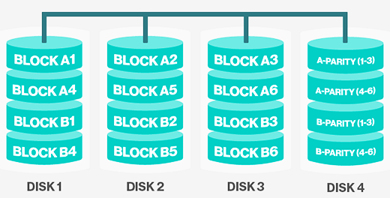
RAID 3 (Byte-level striping with a dedicated parity)
It uses striping and dedicates one drive for storing parity information.
Here single parity bit is computed for each data word and written to a parity drive.
The embedded ECC information is used to detect errors.
As in RAID level 2 the drives must be exactly synchronized.

Slide 52
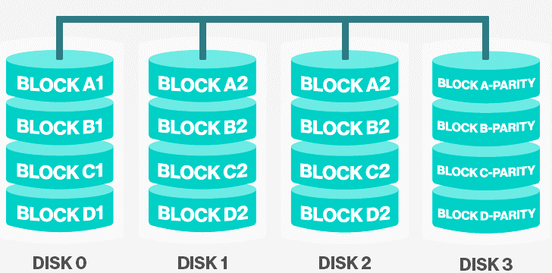
RAID 4 (Block-level striping with dedicated parity)
It uses large stripes (block level striping), which means you can read records from any single drive.
They do not require synchronization of drives.
RAID 4 is like RAID 0, with strip-for-strip parity written onto an extra drive.
If a drive crashes, the lost bytes can be recomputed from the parity drive by reading the entire set of drives.
This design protects against the loss of a drive but performs poorly for small updates, if one sector is changed, it is necessary to read all the drives in order to recalculate the parity.
It creates heavy load on parity drive.

Slide 53
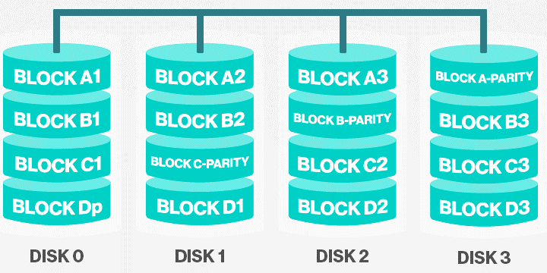
RAID 5 (Block-level striping with distributed parity)
This level is based on block-level striping with parity.
The parity information is striped across each drive.
As with RAID level 4, there is a heavy load in the parity drive, it may become bottleneck.
This bottleneck can be eliminated in RAID level 5 by distributing the parity bits uniformly over all the drives.

Slide 54
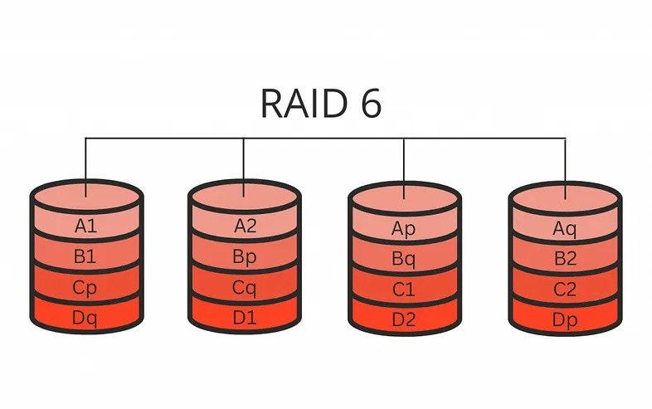
RAID 6
This technique is similar to RAID 5, but includes a second parity scheme that is distributed across the drives in the array. (double parity)
The use of additional parity allows the array to continue to function even if two disks fail simultaneously. However, this extra protection comes at a cost.
RAID 6 arrays have a higher cost per gigabyte (GB) and often have slower write performance than RAID 5 arrays.

Slide 55
RAM Disks
Refers to RAM that has been configured to simulate a disk drive. You can access files on a RAM disk as you would access files on a real disk. RAM disks, however, are approximately a thousand times faster than hard disk drives. They are particularly useful, therefore, for applications that require frequent disk accesses.
Because they are made of normal RAM, RAM disks lose their contents once the computer is turned off. To use a RAM disk, therefore, you need to copy files from a real hard disk at the beginning of the session and then copy the files back to the hard disk before you turn the computer off. Note that if there is a power failure, you will lose whatever data is on the RAM disk. (Some RAM disks come with a battery backup to make them more stable.)
A RAM disk is also called a virtual disk or a RAM drive.
Eg: Imdisk tool kit

Slide 56
Assignment
Write a short note on DMA.
Briefly describe all Disk Arm Scheduling Algorithm.
Write short note on RAID.
Suppose Disk drive has 300 cylinders. The current position of head is 90. The queue of pending request is 36,79,15,120,199,270,89,170 Calculate head movement for the following algorithms. 1. FCFS 2. SSTF
Suppose that a disk drive has 200 cylinders from 0 to 199. The drive is currently at cylinder 53 and previous request at 43. The queue of pending requests in FIFO order is 98, 183, 37, 122, 14, 124, 65, 67.Starting from the current head position what is the total distance (in cylinder ) that the disk arm moves to satisfy all the pending requests for each of the following disk scheduling algorithms: FCFS, SSTF, SCAN, LOOK, CLOOK, CSCAN.

Slide 57
Assignment
Define seek time and rotational latency. Assume that a disk drive has 200 cylinders, numbered 0 to 199. The drive is currently serving a request at cylinder 100. The queue of pending requests is 23, 89, 132, 42, 189. Calculate seek time for FCFS and SSTF disk scheduling algorithm.
Suppose that a disk drive has 5000 cylinders, numbered 0 to 4999. The drive is currently serving a request at cylinder 143,. The queue of pending requests, in FIFO order,86, 1470, 913, 1774, 948, 1509, 1022, 1750, 130Starting from current head position what is total distance (in cylinders) that disk arm moves to satisfy all the pending request for FCFS and SSTF disk scheduling algorithm?

